Slide 1
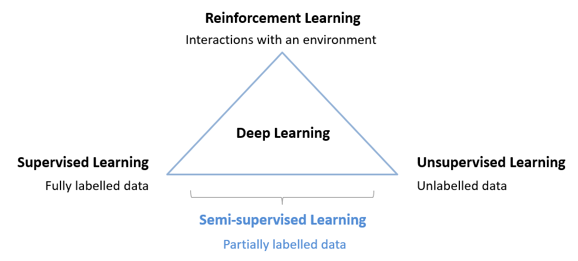
Semi-Supervised Deep Learning
Developed by Titus Tang 2021

Slide 2
Workshop Itinerary
Duration | Event
1 hour | Lecture introducing semi-supervised DL approaches
15 minutes | Break and stretch
1 hour 15 minutes | Hands-on workshop implementing SSDL techniques
15 minutes | Lecture continuation covering misc. advanced/SotA topics
15 minutes | Summary and questions

Slide 3
What’s in the Lecture?
Introduce Semi-Supervised Deep Learning
Discuss various methods of SSDL in the literature
Talk about its strengths and weaknesses
Set expectations

Slide 4
What’s in the Workshop?
Hands-on, guided exercise implementing one method of SSDL
Implement your own variant of SSDL
Show and tell your solution to the group

Slide 5
Assumed Knowledge
This is an advanced course
Assumes fair knowledge of Python programming and TensorFlow
Assumes fair knowledge of key areas of deep learning
Autoencoders
Generative Adversarial Networks
Pre-training, transfer learning, latent variables

Slide 6
What is Semi-Supervised Deep Learning?
Reinforcement Learning
Interactions with an environment
Deep Learning
Supervised Learning
Unsupervised Learning
Fully labelled data
Unlabelled data
Semi-supervised Learning
Partially labelled data

Slide 7
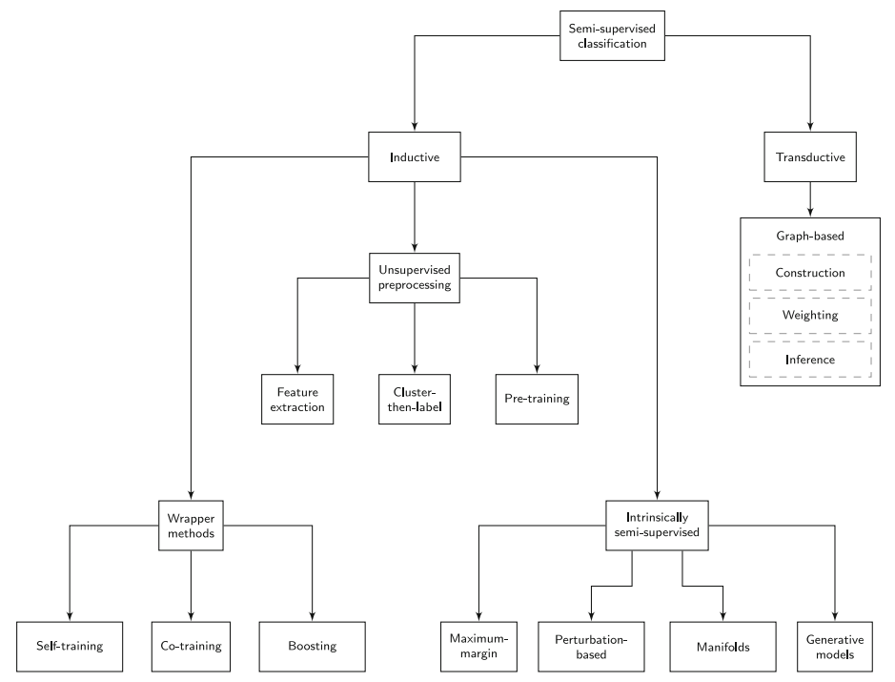
Taxonomy of Semi-Supervised Learning
Based on the review paper:
A survey on semi-supervised learning
https://link.springer.com/content/pdf/10.1007/s10994-019-05855-6.pdf

Slide 8
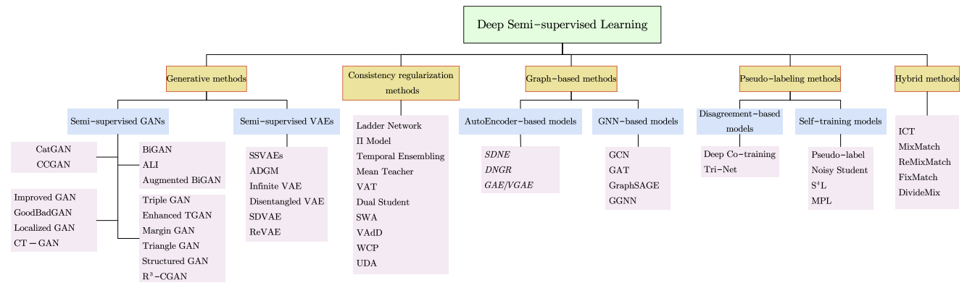
A survey of deep semi-supervised learning
https://arxiv.org/pdf/2103.00550.pdf
Notes:
This is additional reading specifically about SSDL – not covered in this workshop but useful for your reference.

Slide 9
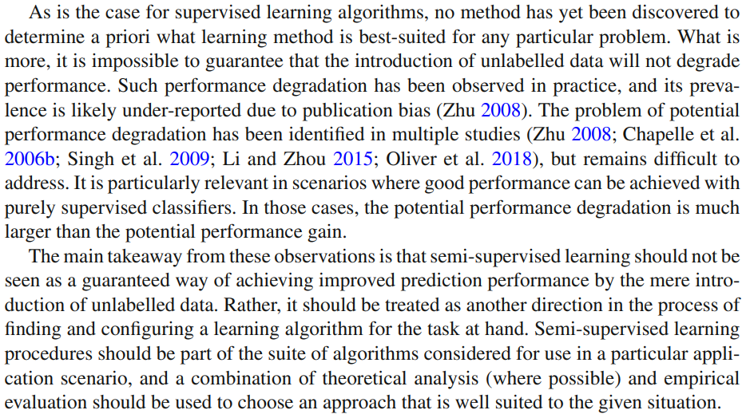
Disclaimer on Semi-Supervised Learning

Slide 10
Disclaimer on Semi-Supervised Learning
There is no free lunch!
Semi-supervised learning (SSL) helps only in some narrow settings.
(Generally,) the better the model’s performance, the less likely SSL will help.
SSL is only a single tool in a toolbox. Use your own judgement.
Many ideas in SSL are applicable broadly across Deep Learning.
If SSL does not work for you, the ideas and techniques you learn today still might!

Slide 11




Assumptions of Semi-Supervised Learning
The smoothness assumption
“If two samples are close in the input space, so too should their labels.”
If they look similar, they are similar.

Slide 12
Assumptions of Semi-Supervised Learning
Decision boundary
The low-density assumption
“The decision boundary of a model should not pass through high density areas in the input space.”
Regions where few samples lie are good class boundaries.
Feature Space

Slide 13











Assumptions of Semi-Supervised Learning
The manifold assumption
“Data points on the same low dimensional manifold should have the same label.”
Data points that have the same features should have the same label.

Slide 14
Wrapper Methods : Self-Training
1
Partially trained model
Some Labelled Data
In the first stage, a model is trained on any available labelled data, resulting in a partially trained model.
NN
2
Unlabelled Data
Predictions
In the second stage, the partially trained model makes predictions on unlabelled data. These predictions are used as labels for further training.
NN
Predictions are used to self-label data

Slide 15
Wrapper Methods : Co-Training
Unlabelled Data
Start with 2 or more base models separately trained on some labelled data.
Infer unlabelled data through the models.
Most confident predictions from one model are used as labels for the other models.
May train on different views of the data, e.g. using data augmentation techniques.
NN
Confident Predictions
Unlabelled Data
NN

Slide 16
Wrapper Methods : Boosting & Bagging
Boosting shown here
Final Prediction
Pseudo-labelled data obtained through self/co-training.
In Bagging, multiple base models are trained separately.
In Boosting, a model’s predictions are used to weight the data to train the next model.
Final prediction is a linear combination of all models.
Correct Predictions
NN
NN
NN
Wrong Predictions
weighted more
Self/Co-Labelled Data

Slide 17

Unsupervised Preprocessing : Feature Extraction
Autoencoder
Usually a 2 stage process: unsupervised then supervised.
During the unsupervised stage, a model (e.g. autoencoder) is trained to learn features in the data.
During supervised training, the decoder is discarded and the pre-trained encoder is fine tuned.
Enc
Dec
Extracted Features
Predictions
Classification Head

Slide 18
Unsupervised Preprocessing : Cluster-then-Label
Unlabelled data
A feature extractor is trained on unlabelled data.
Extracted features are compared and clustered.
Unlabelled data adopts label of closest labelled neighbour.
Labelled data
Labelled and unlabelled data
After clustering

Slide 19
Intrinsically Semi-Supervised : Perturbation based
Perturbate the data, e.g. if images, by transformations in brightness, contrast, crop size, skew, rotation, etc…
The model learns to interpolate the feature space between sparse labels.
Based on the assumption that the feature space between similar data points is smooth.
NN
Perturbation of the data

Slide 20
Intrinsically Semi-Supervised : Perturbation based
Noise layers
Latent vector
Perturbate 2 or more models by adding noise layers (e.g. dropout).
Minimise the differences in the final layer activations of the networks.
Based on the assumption that the feature space represented by the model weights is smooth.
Minimise model latent vectors
Perturbation of the model
Notes:
Imagine two models are trained to caption images.
Noise layers can be imagined to be randomly banning words in the vocabulary.
Example: original caption “A dog and cat are playing ball”
Model 1, the word dog is banned, therefore it will learn to say “A canine and cat are playing ball”
Model 2, the word cat is banned, therefore it will learn to say “A dog and feline are playing ball”
The loss function then tells both models that both sentences are the same, i.e. canine == dog, feline == cat

Slide 21
Generative Models
Train a GAN with N+1 classes.
If the data point is fake, fake class = 1.
If the data point is real, and labelled, the corresponding class = 1.
If the data point is real, and unlabelled, the sum of N classes = 1.
Alternatively, train with only N classes and measure entropy (confidence) of predictions.
Fake data
G
D
N real classes
1 fake class
Real data
A GAN with a discriminator that learns N real classes and 1 fake class

Slide 22

Contrastive Methods
The model learns to predict a representation vector.
Its objective is to minimise distance between vectors of similar object classes and maximise distance between vectors of different object classes.
During inference, compare vector distance between clusters.
Minimise difference
NN
Maximise difference

Slide 23
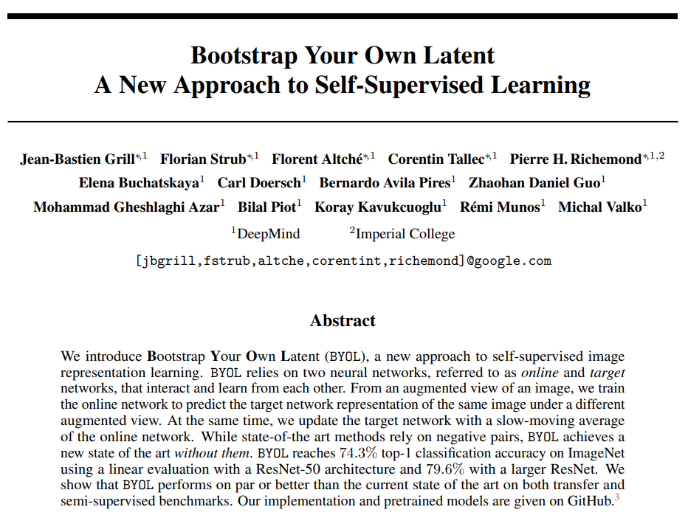
Self-Supervised Learning
Bootstrap Your Own Latent
https://arxiv.org/pdf/2006.07733.pdf
September 2020

Slide 24
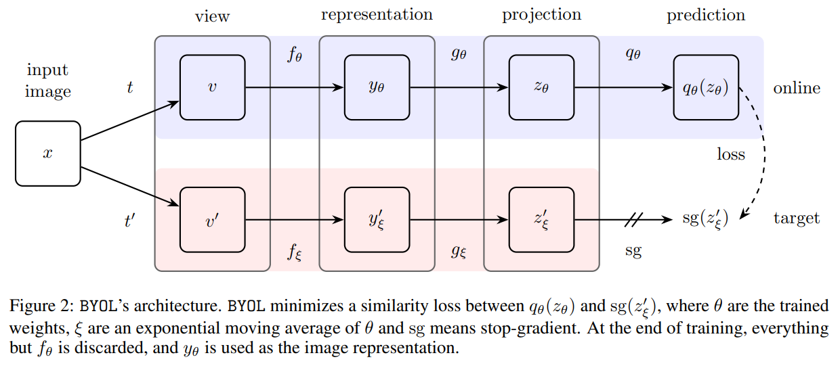


Bootstrap Your Own Latent
Target update:
Decay rate
Online parameters

Slide 25
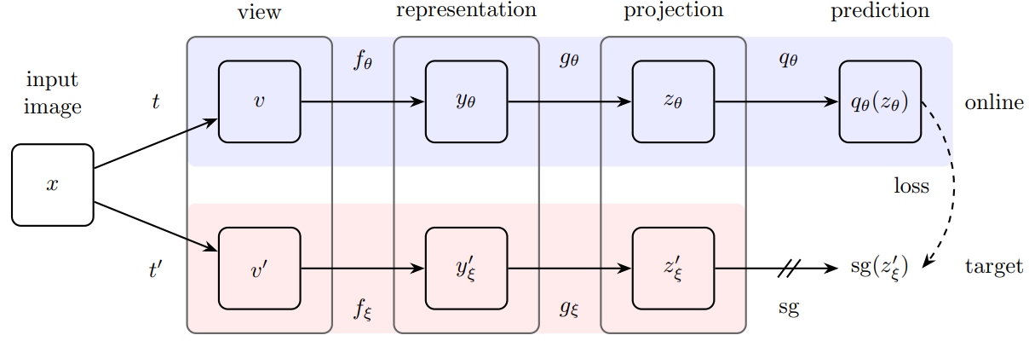
Bootstrap Your Own Latent
Image augmentations
Flip, colour distortion, brightness, contrast, blur…
Output of final average pooling (1x2048)
2 layer MLP (4096, 256) with BN, ReLU
Target update:
Online network
(ResNet-50)
Decay rate
Online parameters
Target network
(ResNet-50)
Notes:
Question 1: Why does the network not collapse to a trivial solution?
The trivial solution is itself unstable. For example, the predictor could be an identity-like function, but that means the projector is a constant, which is very unlikely to happen.
Question 2: How can this system learn when it does not utilize any labels and essentially learns from itself?
My intuition of this paper: The predictor is essentially predicting what past versions of itself would have “projected”.
This is similar to meta learning; learning about how past-selves would learn.
Think about how learning math over a lifetime is like (primary, secondary school, uni).
If there is a math problem asking about integration, how do you (your current self) think your younger selves would solve the problem?
Your primary school self would give a bad guess. Your secondary school self would provide a better answer, etc.
How do you know this? That is because you understand the math problem and its context – because you understand math!
If you are trained to predict how your younger self would respond to the math problem, you are indirectly being forced to learn the math.

